Slide 1
CS 470 Project Two Conference Presentation: Cloud Development
Candace Ralston
06/23
Notes:
Hello and I am here to talk about Cloud Development.

Slide 2

Overview
My name is Candace Ralston-student
About serverless cloud, containerization, and orchestration
Notes:
My name is Candace Ralston-student at SNHU. This is about the serverless cloud, containerization and orchestration. This explains how the serverless cloud works. As well as how containers work and orchestration.

Slide 3
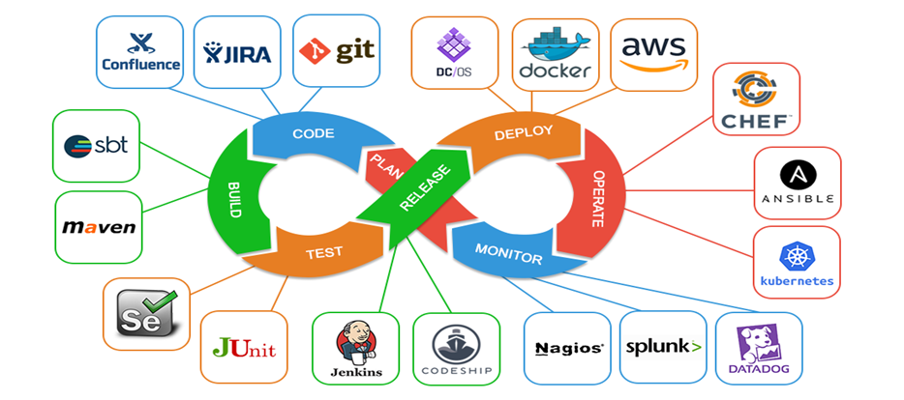
Containerization
Outline Reasons
People Involved
Organize Cloud-Readiness
Choose Cloud Vender
Design Environ
ment
Create Roadmap
Get Application Ready
Migrate Data
Testing/ Switch
Notes:
Containerization is the packaging of software code with just the operating system libraries and dependencies required to run the code to create a single lightweight container that runs consistently on any infrastructure. They basically allow developers to create and deploy applications faster and more securely. (Use the tables)

Slide 4
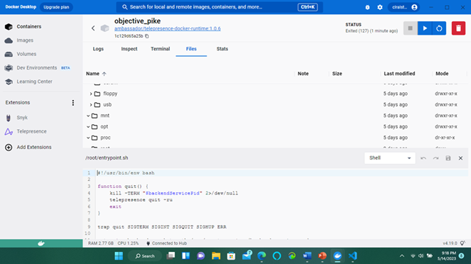
Orchestration
A docker Compose is a tool that was developed to help define and share multi-container applications.
Notes:
Next the orchestration is the automated configuration, management, and coordination of computer systems, applications, and services. It helps IT to more easily manage complex tasks and workflows. To the right is a screenshot of an orchestration.

Slide 5
The Serverless Cloud
Pros | Cons
No server management | Testing and debug are challenging
Charged for used space | Security concerns
Scalable | No long-running processes
Quick deployment and updates | Performance affected
Code runs closer to user | Lock-in is a risk
S3 Storage | Local Storage
Data Retrieval | Data Retrieval limit
Collaboration | No Collaboration
Disaster Recovery | Limited Disaster Recovery
Subscription Pay | More/adding & upgrading
Green Business | More Waste
Increased Capability | Limited Capability
Notes:
There are pros and cons to the serverless cloud (use table). Scalable is the property of a system to handle a growing amount of work. Long-running processes are computer database transactions that avoid locks on non-local resources. That however outweighs the comparison between the AWS S3 storage and the local storage (use table).

Slide 6
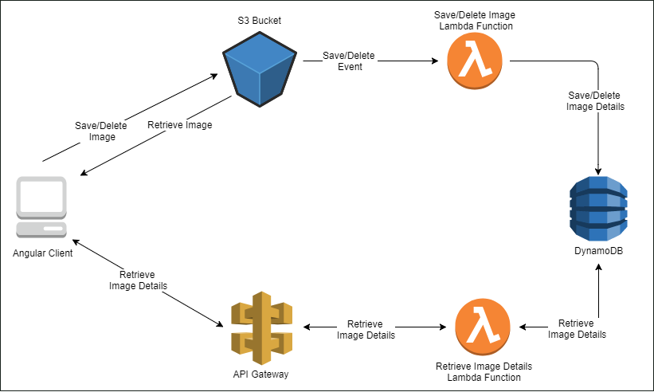
The Serverless Cloud
Lambda
AWS
Event-Driven
Serverless Computing Platform
Notes:
One of the compute services that AWS uses is Lambda. This is a serverless, event-driven compute service that lets you run code for virtually any type of application or backend service without using servers. Use the diagram.

Slide 7
The Serverless Cloud
 | MongoDB | DynamoDB
Run Anywhere | Deploy Anywhere | AWS
Data Model | JSON Based | Limited key-value
Querying | Query Language | Key-value Queries
Indexing | Robust/Easy | Limited/ Complex
Data Integrity | Strong Consistent | Eventually Consistent
Database
Queries used
Get all questions
Get all answers
Get a single question
Get a single answer
Lambda Script
Notes:
There are two NoSQL databases that are source-available cross-platform document oriented database programing. NoSQL databases provides a mechanism for storage and retrieval of data that is modeled in means other than the tabular relations used in relational databases. These are MongoDB which uses JSON-like documents with optional schemas (the structure of a database that describes in a formal language supported typically by a relational database management system). The other one is DynamoDB which is also an NOSQL database that offered by Amazon as a part of the AWS services portfolio. Like everything else like this there is a good and a bad side to using these (use table). For the main database we used the queries (use table) and Lambda script which is a event-driven serverless part of AWS.

Slide 8
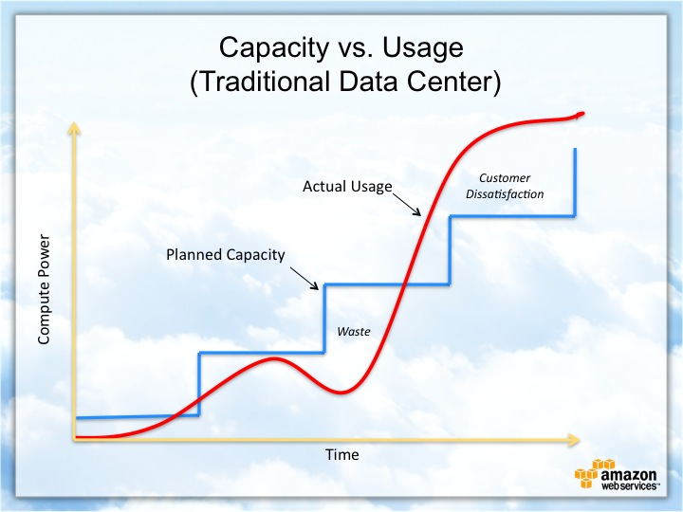
Cloud-Based Development Principles
Elasticity:
Acquire resources as need them and
release resources
Pay-for-use model:
easily adapt to changing business needs
by only buying the storage space needed
Notes:
This next one is for the cloud-based development principles. These are elasticity and pay-for-use model (on the right). These are (use above). The table is the capacity vs. usage table (use table). Since it is a pay-for-use model the company here actually paid less then they thought.

Slide 9

Securing Your Cloud App
Access
Multi-Factor Authentication (MFA)
Strong Passwords
Physical Security Practices
Monitoring User Activity
End point Security
Notes:
This is the start to securing your cloud application. There are many ways to access the cloud application while making sure that only the right users access it. One of these is the multi-factor authentication, which requires two or more proofs of identity to grant you access to your accounts or applications. Another one is the strong passwords, which gives you a key or password that only you know and can use. Still another one would be physical security practices, which are security measures that are designed to deny unauthorized access to facilities, equipment, resources, and people. These can be locks on doors, walls, and cameras. Another one is monitoring user activity, which is the monitoring and tracking of end user behavior on devices, networks, and other company-owned IT resources. There are items that they can put on computers and devices that can help monitor and stop user activity. The last but not lest one is endpoint security, which is an approach to the protection of computer networks that are remotely bridged to client devices. Such as laptops, tablets, and phones.

Slide 10

Securing Your Cloud App
Policy | Role
Users have access to technology resources | Users are authenticated
Permissions of identity | Users are authorized
IAM regulates access to AWS | Give necessary permissions
Allow or deny user to a resource | Give as many as needed
Identity-based | Good as making new permissions
Resource-based | Applied to policies
Notes:
There are different policies and roles to securing the cloud application. A few of these are (use table). Identity and access management (IAM) is a security and business discipline that includes multiple technologies and business processes to help the right people or machines to access the right assets at the right time for the right reasons, while keeping unauthorized access and fraud at bay. New permissions like with new hires or with people who moved up in the company.

Slide 11
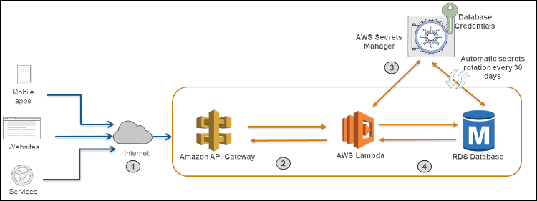
Securing Your Cloud App
API Security
Roles Based Access Control (RBAC)
AWS identity and IAM
a version of RBAC
Can create additional IAMs role
Notes:
Still another way of securing the cloud application would be making sure of the API security. Application programming interface (API) is away for one piece of software to interact with another piece of software. API security is the process of protecting APIs from attacks. This is the core component of web application security. How is works is described in the diagram to the right (use diagram).

Slide 12

Conclusion
How to work with containerization and orchestration.
What is a cloud-based, serverless system
Securing your cloud application
Notes:
Thank you for your time. With the knowledge I have given you like (read above) I hope this helps in getting you to understand a serverless/cloud application. The last slide is just the references that I used. Have a good day!

Slide 13
References
Ghosh, A./May 25,2019/DevOps and Containerization Tools (thecustomizewindows.com)
De Vos, C./May 8,2020/8 Cloud Migration Steps for Moving Applications to the Cloud (resolutets.com)
Use Docker Compose | Docker Documentation
Why use serverless computing? | Pros and cons of serverless | Cloudflare
Villanueva, J./Oct. 25, 2022/Amazon S3 vs Local Storage - Where Should You Store Files Uploaded to Your File Transfer Server? | JSCAPE
Climer, S./Mar. 26, 2019/Cloud Storage Vs Local Storage: What’s The Right Choice For You? | Mindsight (gomindsight.com)
Taylor, D./April 29,2023/What is AWS Lambda? Lambda Function with Examples (guru99.com)
Comparing DynamoDB And MongoDB | MongoDB
Unauthorized Access: 5 Best Practices to Avoid Data Breaches (cynet.com)
Magnusson, A./Feb. 9, 2023/AWS IAM Roles vs Policies: What's the Difference? | StrongDM

